Slide 1
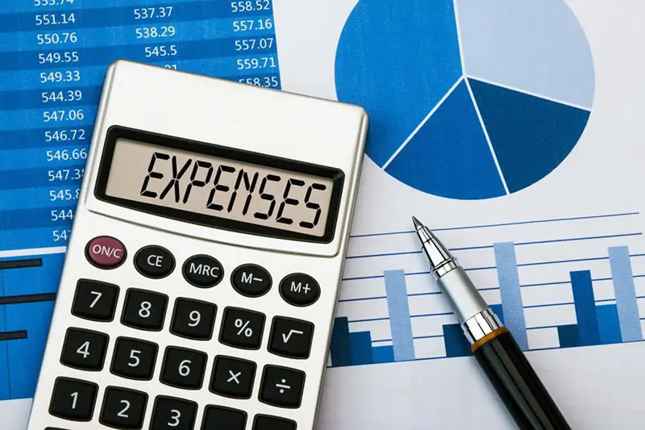


Estimation of Business Expenses
By:
Dharsha
Iswarya
Dhanya
Shanuka

Slide 2

Problem
Estimating business expenses cabe a challenging process, and various problems may arise during the estimation process Insufficient or unreliable historical financial data can make it difficult to make accurate estimations. This problem is especially prevalent for startups or businesses in their early stages. Business environments change over time, and failure to regularly update expense estimates can lead to outdated budgets that don't reflect current conditions.

Slide 3

Analysis
This budget outlines the expected costs for a specific period, typically a year, and is used as a guideline for financial planning. Conducting regular variance analysis can provide insights into the accuracy of your expense estimations. Comparing actual expenses to the budgeted amounts can help identify areas where adjustments may be needed. Accurate expense estimations are critical when seeking investment or loans. Investors and lenders will want to see that the business has a clear understanding of its financial obligations and is managing expenses effectively.

Slide 4

Solution
Begin by categorizing expenses into fixed and variable categories. This will help you better understand the nature of each cost and how it behaves over time. Develop a comprehensive budget that outlines all expected expenses for a specific time period (usually annually). The budget should be detailed, specifying the estimated amount for each expense category. Regularly review and reassess your expense estimates, making adjustments as necessary to reflect changing circumstances. Creating a robust solution for estimating business expenses involves a combination of financial analysis, strategic planning, and ongoing monitoring

Slide 5
DASHBOARD

Slide 6
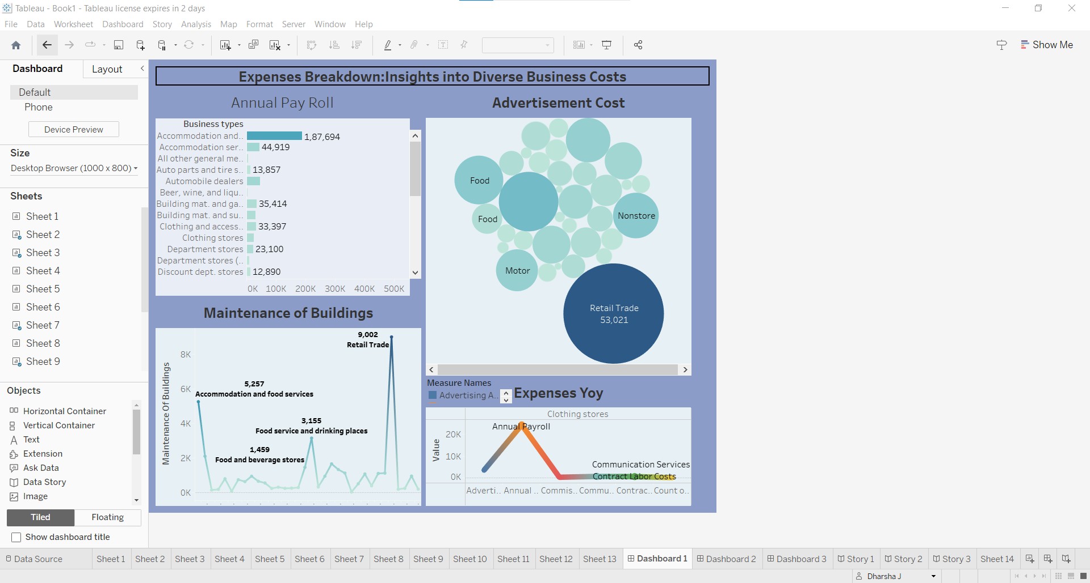

Slide 7
STORY

Slide 8
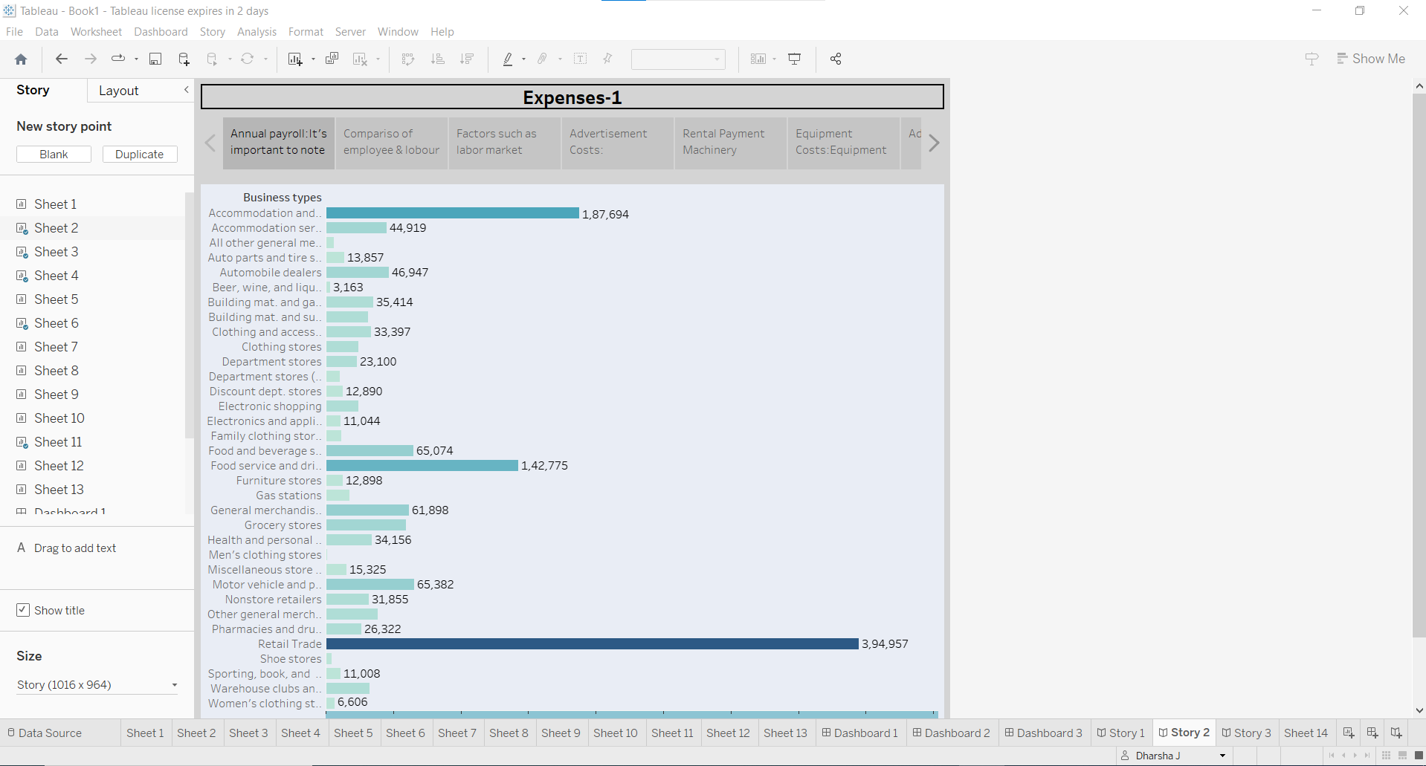

Slide 9

Conclusion
. A comprehensive budget that details expected expenses is a foundational step in expense estimation Staying informed about market conditions and industry benchmarks is crucial for more accurate estimates. Regularly reviewing expenses and seeking cost reduction opportunities can help improve financial efficiency. It's an integral part of financial management that supports effective decision-making, financial stability, and the achievement of the organization's long-term objectives.

